Slide 1

Can Twitter Save Lives? A Broad-Scale Study on Visual Social Media Analytics for Public Safety
Dennis Thom, Robert Krüger, Thomas Ertl
Nitish Dhakal
nitishdhakal@u.boisestate.edu
Boise State University
November 14, 2016

Slide 2
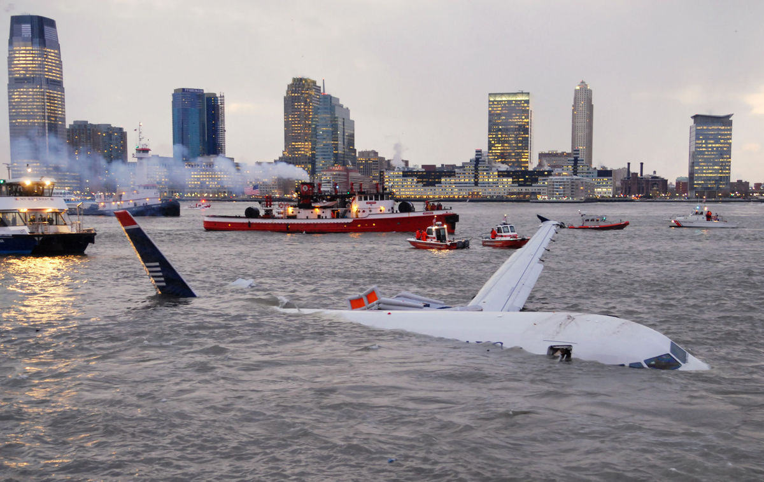
Hudson River crash 2009
Image Source: CNN
Notes:
US Airways A320 plane crash, January 15 2009. survivors 155(all)

Slide 3
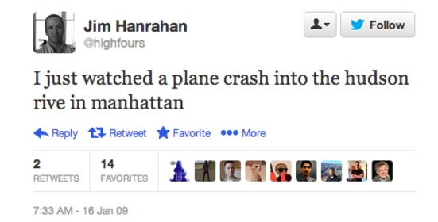
Hudson River crash 2009
Image Source: CNN
Notes:
US Airways A320 plane crash, January 15 2009. survivors 155(all)

Slide 4
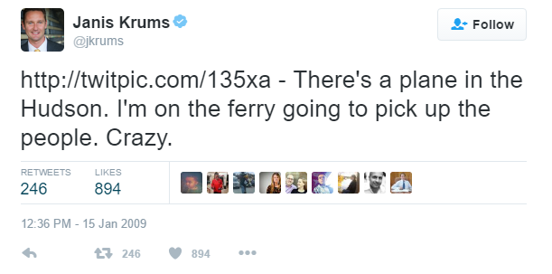
Hudson River crash 2009
Image Source: CNN
Notes:
US Airways A320 plane crash, January 15 2009. survivors 155(all)

Slide 5
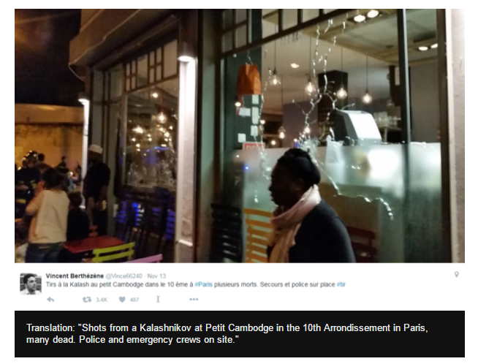

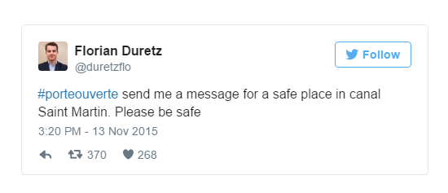
Paris Attacks 2015
#notafraid
#PrayForParis
Image Source: BBC

Slide 6
Crisis Management is a Challenge
Broken social order during crises hinders search, rescue and relief operations, as well as impedes restoration of normal life.
Traditional media like telephone service, radio and television transmissions gets hit the hardest.
Notes:
Crisis management is a challenge for people involved in disaster management and humanitarian assistance.

Slide 7
Social medias in public safety
Provide real time observation
Tremendous help in disaster response , critical infrastructure management and general public safety
Visual analytics combining machine learning, natural language processing, interactive graphical interfaces can provide better insights, anomalies and trends in the data.

Slide 8
Commercial systems for public safety
Social media use for public safety is in the middle of commercialization and practical adoption
Tested in hypothetical scenarios
This papers tries to fill this gap by providing 2 phase study on visual analytics in public safety.

Slide 9
Commercial systems for public safety
In the first study, 29 practitioner from disaster response and critical infrastructure participated in crisis management task for 2013 German flood
Out of 29, half were from people working at critical infrastructures in private sector
Other half were from government disaster response program
Used visual analytic system called “ScatterBlogs”.
Notes:
Half Practitioners were employed at commercial organizations working at critical infrastructures and half government authorities in diasaster resposne

Slide 10
In the second study, took feedback from experts, redesigned the system with lesser interactions and more automations .
The system is called “Event Digest”.

Slide 11
ScatterBlogs
Real world social media monitoring and analytics software
Handles large scale social media data.
Can do stream enabled real time visualization.
Adaptable to changes
Works with YouTube and Flickr as well.
Notes:
Twitter provides large volume of freely available data

Slide 12
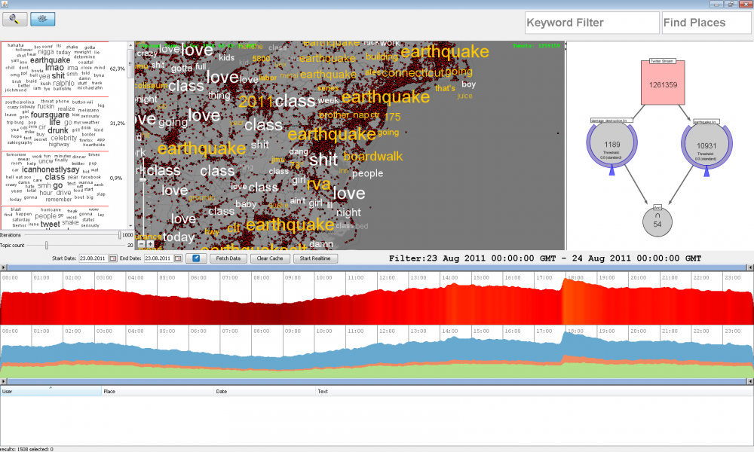

Slide 13
1. Real time overview and filters
Coping with real time data real challenge
500 million tweets, 15 million with geo coordinates
Uses Apache Lucene for indexing, and Open StreetMap for showing the view
Notes:
Large scale data demands scalable and streaming enabled data structures and visual interfaces
With apache lucene and open street map they can support real time view upto 5 million messages
The above view is temporal view

Slide 14
2. Message sentiments
Shows temporal view of 3 sentiments; positive, negative and neutral
Shows the temporal view of volume of tweets

Slide 15
3.Keyword wise tweet filtering

Slide 16
4. Topic models
Aggregates and organizes documents topics
ScatterBlogs uses MALLET, an implementation of LDA (Latent Dirichlet Allocation)
Shown as tag cloud
Notes:
Mallet: mallet.cs.umass.edu
User can adept to granularity of topic extraction through the sliders

Slide 17
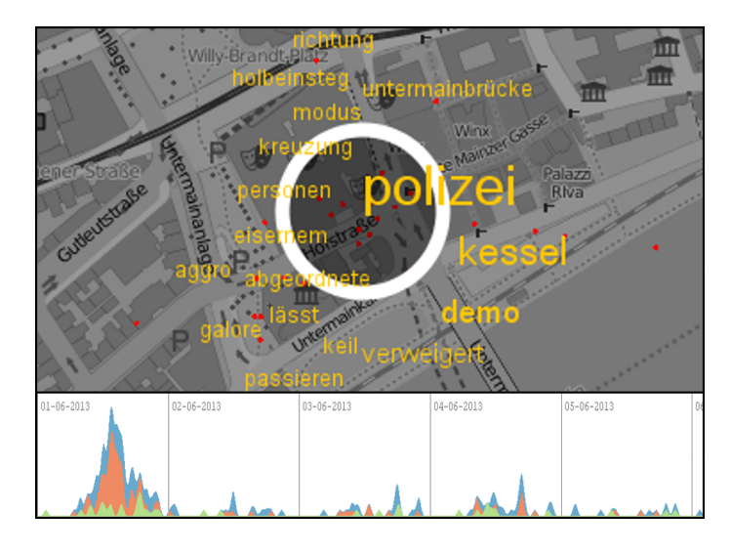
5. Content Lens
Provides focus and content in visual analytics
Upon hovering to the area shows the relevant messages tags
User can apply temporal filters to this
Notes:
Uses tf-idf
Scales the size of tags based upon relevance

Slide 18
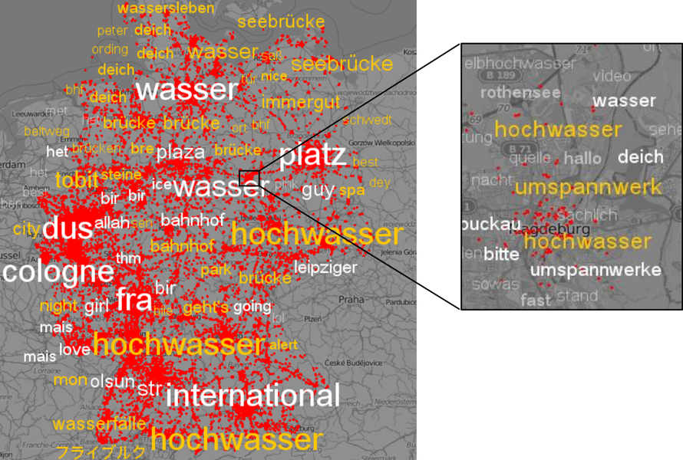
ScatterBlogs-Other features
1. Event Discovery
Uses cluster analysis to detect messages that are spatio-temporally close and share the same topic

Slide 19
ScatterBlogs-Other features
1. Event Discovery
Uses cluster analysis to detect messages that are spatio-temporally close and share the same topic
Find the anomalies in critical events like earthquake, riots

Slide 20
ScatterBlogs-Other features
1. Event Discovery
Uses cluster analysis to detect messages that are spatio-temporally close and share the same topic
Find the anomalies in critical events like earthquake, riots
Highlights the tag in a zoomable map called TagMap

Slide 21
ScatterBlogs-Other features
2. Classifier management
Web results are optimized but crisis management should have high recall.
ScatterBlogs has a set of SVM-classifier trained for particular topics.
Analyst can select the classifiers of their choice to reliably detect calamities.
Can even combine two classifiers
For example: analyst can combine classifier that detects flood related massage with the one that detects damage related messages to view the flood damage.
Notes:
Even one incident shouldnot be left unnoticed

Slide 22
Phase-1 Field Study

Slide 23
Overview
Experts are from Critical Infrastructures and crisis response domain.
Experts need to evaluate the techniques and tools under real world condition.
Collected 2013 German Flood tweet data from June 1 to June 10
Designed 4 tasks related to crisis Intelligence.
Participants have to solve these tasks using the ScatterBlogs.
Notes:
Critical Infrastructures-Energy supply co, railways, gas and heating. They were familier with infrastructure management systems which provided topological and geographical visuals.
Crisis response-civil service, public relations, press officers, volunteers at least eight years of experience

Slide 24
Study Setup
One session, 2 hour.
Studies were all audiotaped
10 minutes presentation given by the team
Instructor introduced task and accumulated comments
After task completion participants had to rate the tool from 1(less useful) to 10 (very useful)

Slide 25
Data and tasks
https://www.youtube.com/watch?v=UV7j-x5DSdY

Slide 26


Slide 27
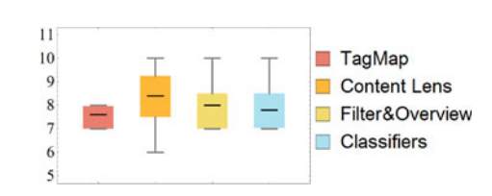
Results
Figure: Box plots of ratings for usefulness of tools (1 very useless 10 very useful)
Notes:
Overall task performance good
Everybody solved the problem in 1-2 minutes
Average usefulnesss 7-9
Participants overwhelmed by the result given by tag map. All probability results shown which could be annoying for first time users
Users had trouble understanding content lens and tag map.
Content lens shows the relevant tags in the hovered area of the map while tag map is showed only when the spatiotemporal cluster of similar messages (used in event detection) are detected.

Slide 28
Comments and Suggestions
The idea “interesting and needed”.
Real time detection good feature.
Might not be enough available time and staff to employ such highly interactive, exploratory tools.
Stronger concerns about reliability of the data and/or credibility of the social media users.
Social Media monitoring could be used as assistant tool not the main one.
Tag map showed too much information and confusing initially.

Slide 29
Recommendations—What features are missing in the system
Images and videos instead of texts.
TagMap should show images aggregation directly in map.
Develop tools for credibility checks of event reporters.
Map should be shown in full screen
Notes:
Images and videos gives the responders both a better means to verify eyewitness data and a more easy way to truly assess the severity of the ongoing situation.

Slide 30
Lesson Learned
Users were overwhelmed by interaction and exploring capabilities
Experts requested to reduce interactivity and free exploration
Users need some time to get mastered with the tools.
Need to rely on simplified and fast indicators
Need for plain situation monitoring and thorough crisis intelligence
Notes:
In case of time-critical decision making environment lots of interactivity does not help.
Various participants indicated that in the fast-paced environment of disaster response, there would hardly be enough time or staff available to conduct any highly interactive, in-depth data analysis tasks
Decentralized disaster response and management in Germany is largely conducted by volunteers who only occasionally gather in situation rooms during critical events. They are thus usually not trained to work with dedicated information technology.

Slide 31
Phase-2 Adapted Approach

Slide 32
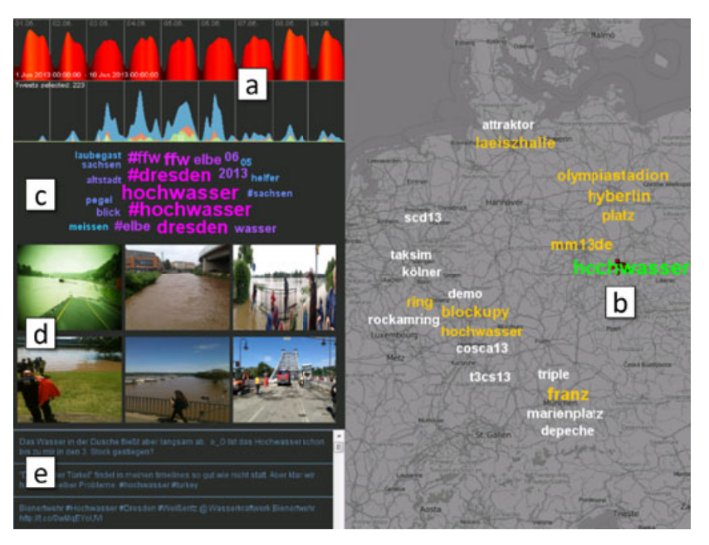
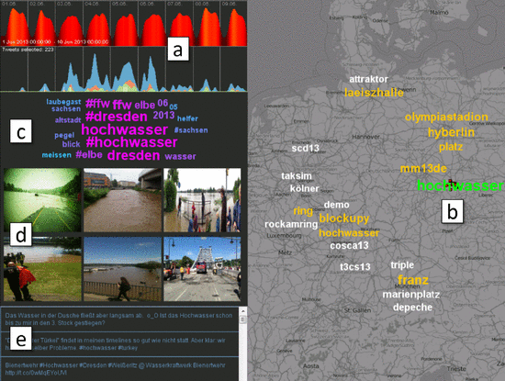
Event Digest
Notes:
The visualizations of the first stage were optimized for recall in order to prevent the analysts from missing any important event.
But the users were interacting and exploring large volumes of possibly irrelevant data,
New system just focus on events which is central entity in situational monitoring and hence called event digest

Slide 33
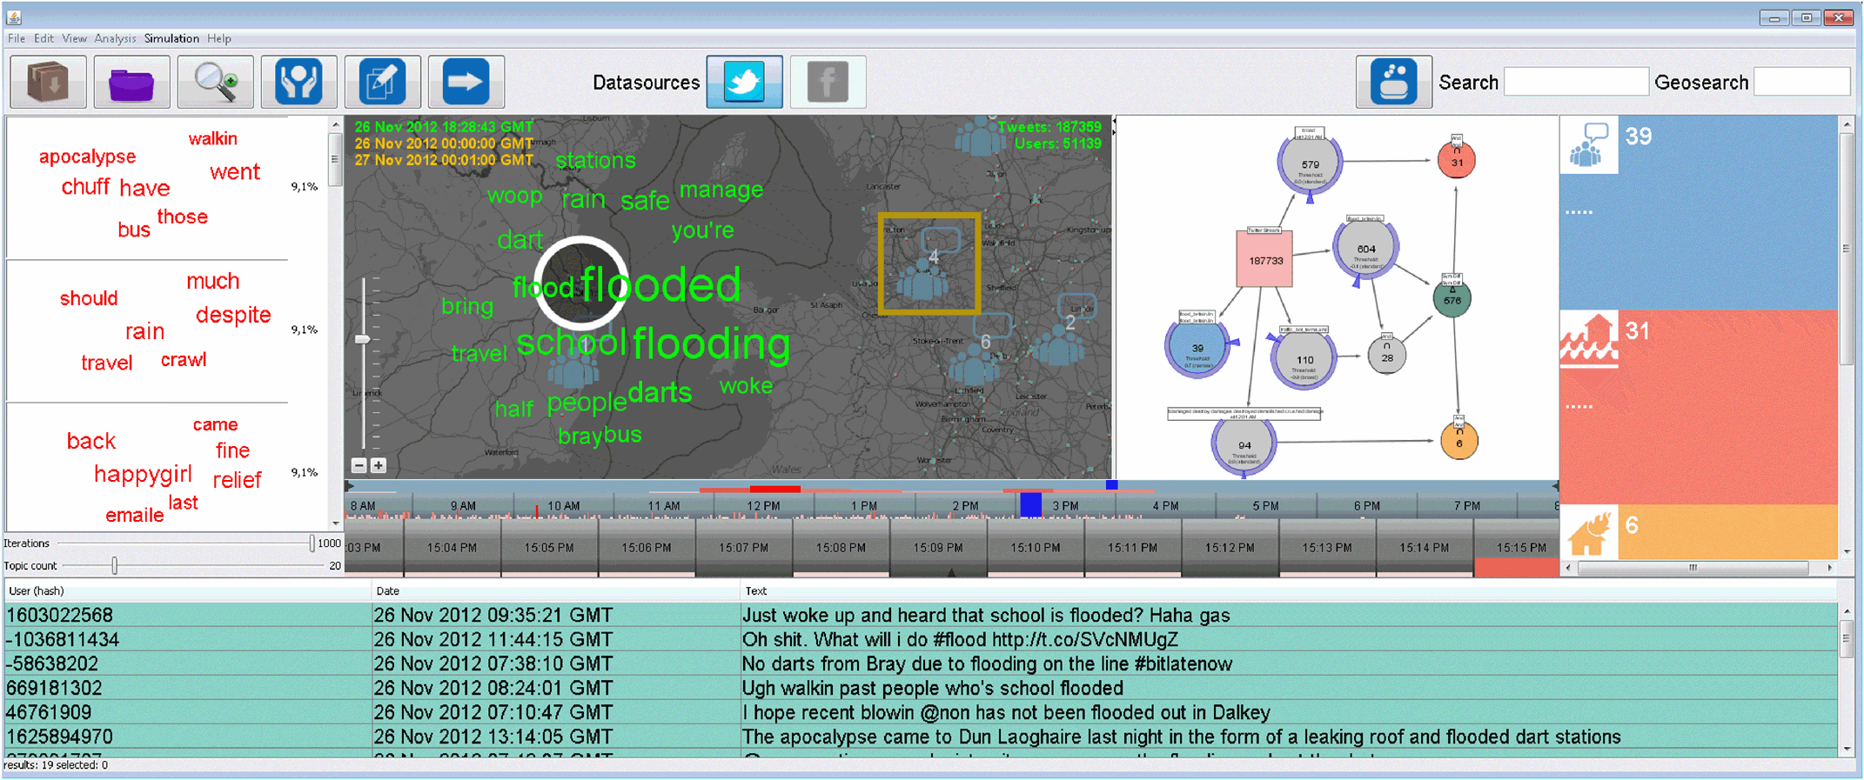
ScatterBlogs

Slide 34
Event Digest
Notes:
The visualizations of the first stage were optimized for recall in order to prevent the analysts from missing any important event.
But the users were interacting and exploring large volumes of possibly irrelevant data,
New system just focus on events which is central entity in situational monitoring and hence called event digest

Slide 35
Event Digest
a. Time Frame
Notes:
The visualizations of the first stage were optimized for recall in order to prevent the analysts from missing any important event.
But the users were interacting and exploring large volumes of possibly irrelevant data,
New system just focus on events which is central entity in situational monitoring and hence called event digest

Slide 36
Event Digest
b. Events highlighted in map
Notes:
The visualizations of the first stage were optimized for recall in order to prevent the analysts from missing any important event.
But the users were interacting and exploring large volumes of possibly irrelevant data,
New system just focus on events which is central entity in situational monitoring and hence called event digest

Slide 37
Event Digest
c. Select tags to get detail digest of the topics
Notes:
The visualizations of the first stage were optimized for recall in order to prevent the analysts from missing any important event.
But the users were interacting and exploring large volumes of possibly irrelevant data,
New system just focus on events which is central entity in situational monitoring and hence called event digest

Slide 38
Event Digest
d. Images
Notes:
The visualizations of the first stage were optimized for recall in order to prevent the analysts from missing any important event.
But the users were interacting and exploring large volumes of possibly irrelevant data,
New system just focus on events which is central entity in situational monitoring and hence called event digest

Slide 39
Event Digest
e. Messages related to event
Notes:
The visualizations of the first stage were optimized for recall in order to prevent the analysts from missing any important event.
But the users were interacting and exploring large volumes of possibly irrelevant data,
New system just focus on events which is central entity in situational monitoring and hence called event digest

Slide 40
Event Digest-Major changes
Focuses on notion of events.
Combines anomaly detection, relevance weighting, and message classifiers.
Hides all information with low probability of being related to any significant event.
Implements a metric to quantify the credibility of Twitter users and messages.

Slide 41
Event Detection in Event Digest
After selecting time frame and zooming to map area user is presented with top 10 events as a tag map
System checks automatically whether these tags are related to any classifiers in library
If any tags messages matches to classifier, more such event related messages are searched .
Upon clicking the tag all tag related messages are shown
Notes:
More tag related messages subsequently boosts the tag score

Slide 42
Relevant Media Display in Event Digest
Medias are aggregated using spatio temporal clustering approach

Slide 43
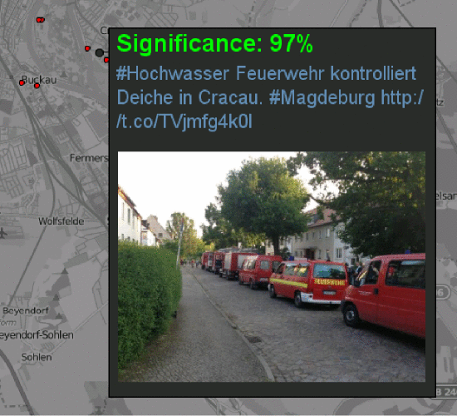
Significance Score in Event Digest
Calculated to find the trustworthiness or credibility of users and messages
60 relevant features to train the classifier
Important feature include number of status, followers, friends in network etc.

Slide 44
User Study
Comparison between ScatterBlogs and Event Digest
20 voluntary participants, each rewarded with 10 euros
Same data and tasks as before
2 groups (one for ScatterBlogs and one for Event Digest)
1 hour session each
Participants filled the questionnaire after completion of user study
Notes:
No experts selected.
These participants were not experts in disaster management or critical infrastructure management.

Slide 45
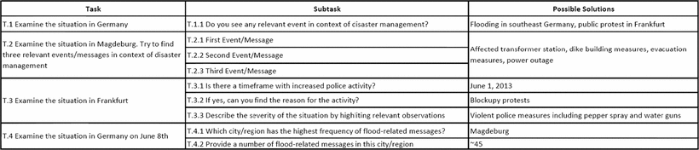
Tasks

Slide 46
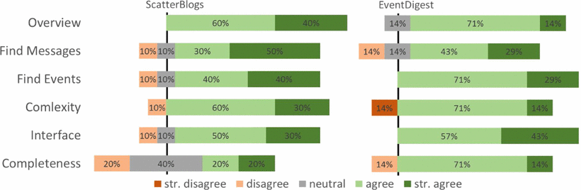
Questionnaire
Figure: Result of Likert-style questions for ScatterBlogs & Event Digest.
Notes:
Used 5 point likert scale
Controversial to the previous claim that scatterblogs is a complete solution, only 40 % agree to this
Authors believe that higher interactivity and free exploration also lead to a higher feeling of responsibility for the users’ actions.
If users are provided with more options, they also have more options to do things wrong.
They get feeling that they have missed or done something wrong
While in event digest although system might have missed important thing but user has sense of doing everything right

Slide 47
Conclusion
ScatterBlogs
Users prefer crisis management systems to perform both simple data monitoring and more in-depth crisis intelligence
This preference depends on the 3 things
Tasks to be performed
The severity of situations, and
The analyst's field of expertise.
ScatterBlogs was more demanding in terms of interaction
Notes:
The field study showed experts prefer a system that is less demanding in terms of interaction and exploration and that provides more enhanced means of automatically showing important information

Slide 48
Conclusion
Event Digest
Simplified system which mainly relies upon automated indication and requires less interactions.
Feature to detect credibility of message/user was popular.
More suitable to user without expertise, fast, easy to learn.
For more indepth analytical approach ScatterBlogs performed better.
Notes:
The field study showed experts prefer a system that is less demanding in terms of interaction and exploration and that provides more enhanced means of automatically showing important information

Slide 49
Questions??

